Slide 1
SI671/721
Discussion 6
Networks
Notes:
Slides adapted from Yulin Yu (SI671 21fall) and Zihan Wu (SI671 22fall)

Slide 2
Outline
Basic network concepts review
Network types
Transitivity
Clustering coefficient
Centrality
PageRank
Link Prediction
Networkx: https://networkx.org/documentation/stable/tutorial.html

Slide 3
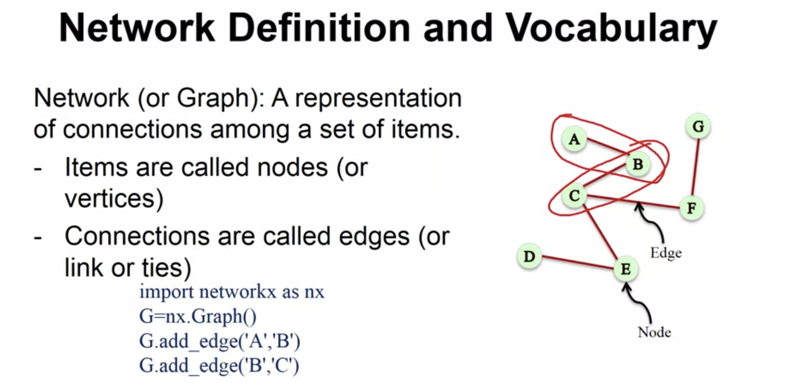

Slide 4
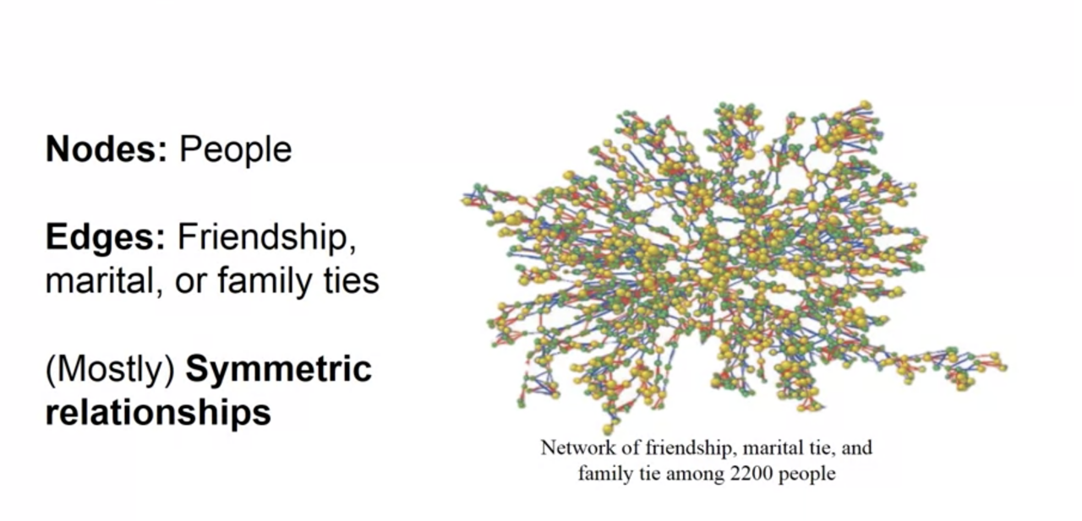
Undirected Graph

Slide 5
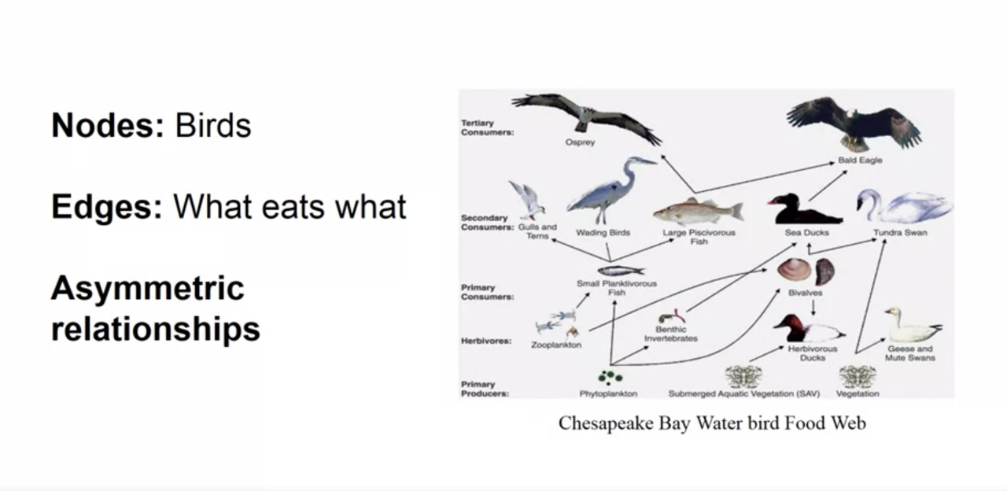
Directed Graph

Slide 6
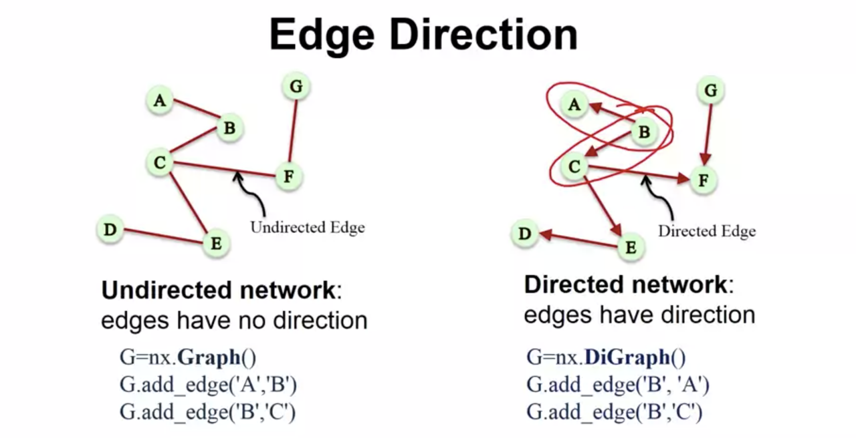

Slide 7
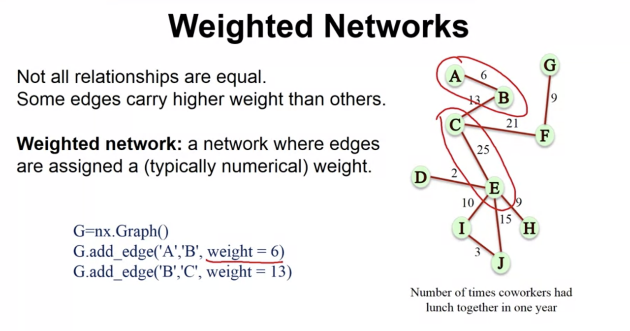

Slide 8
Some Network Properties
Distance
Clustering
Degree
Centrality
……

Slide 9
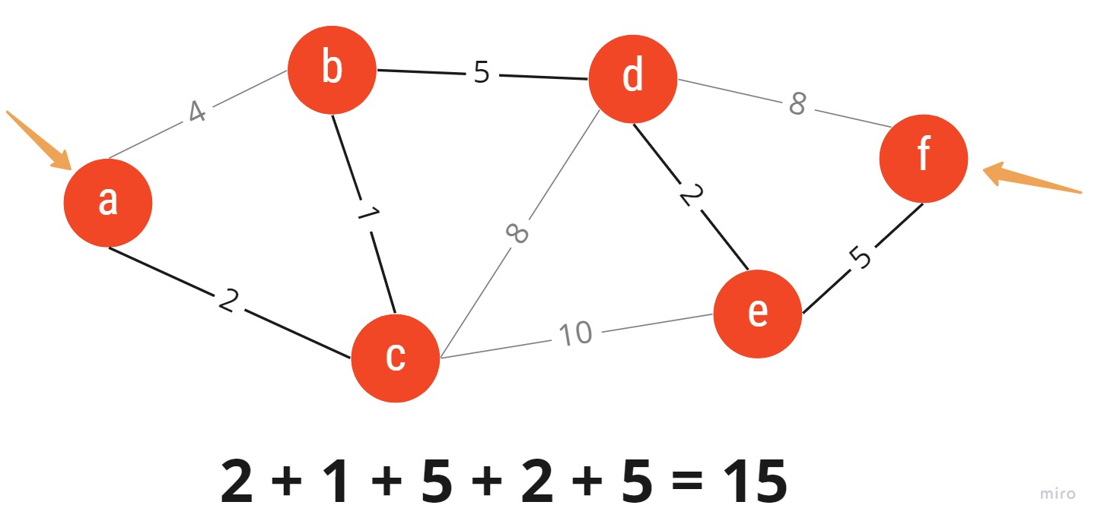
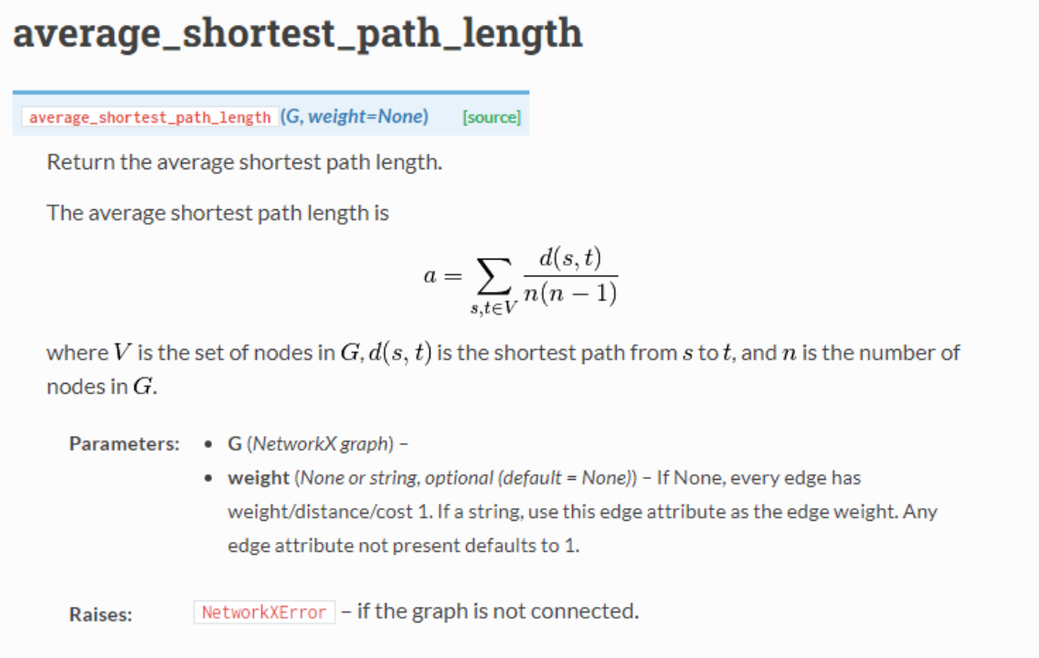
Distance

Slide 10
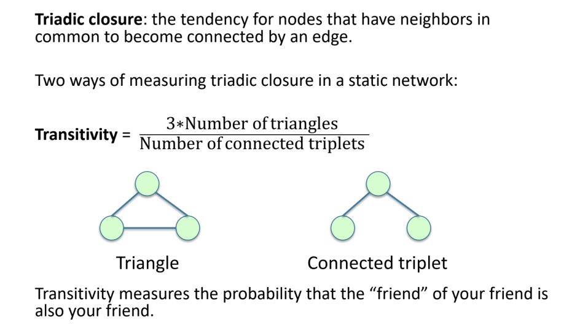
Transitivity

Slide 11
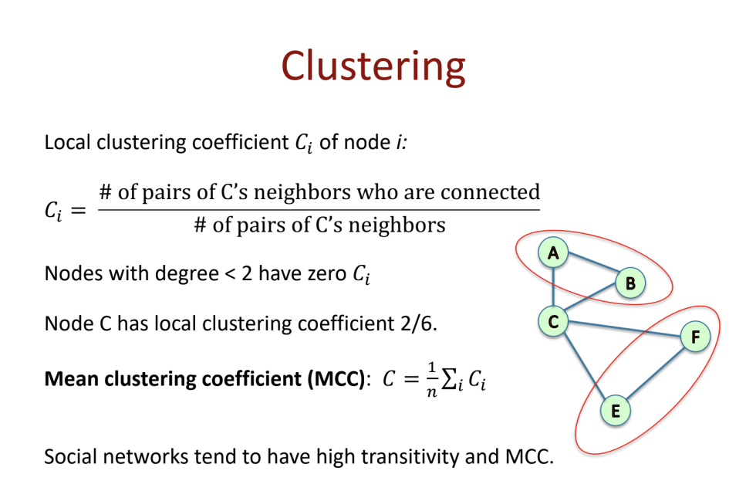

Slide 12
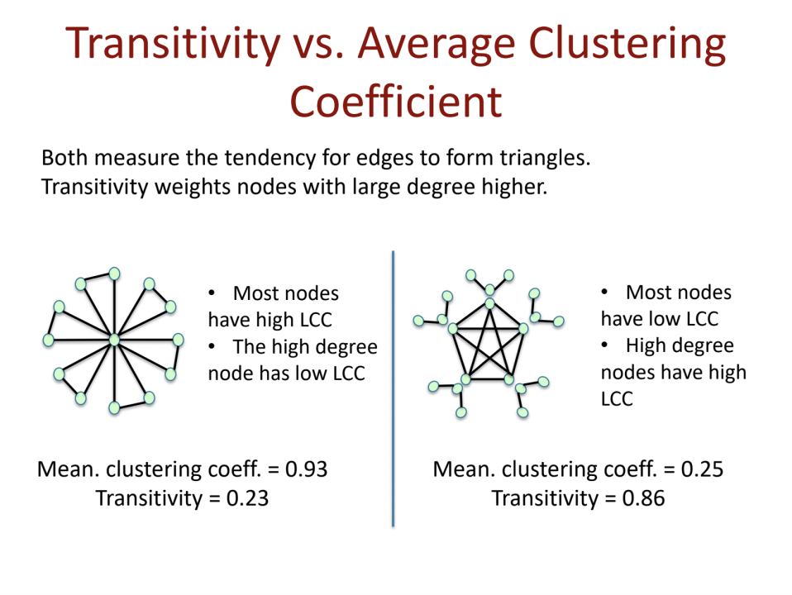

Slide 13
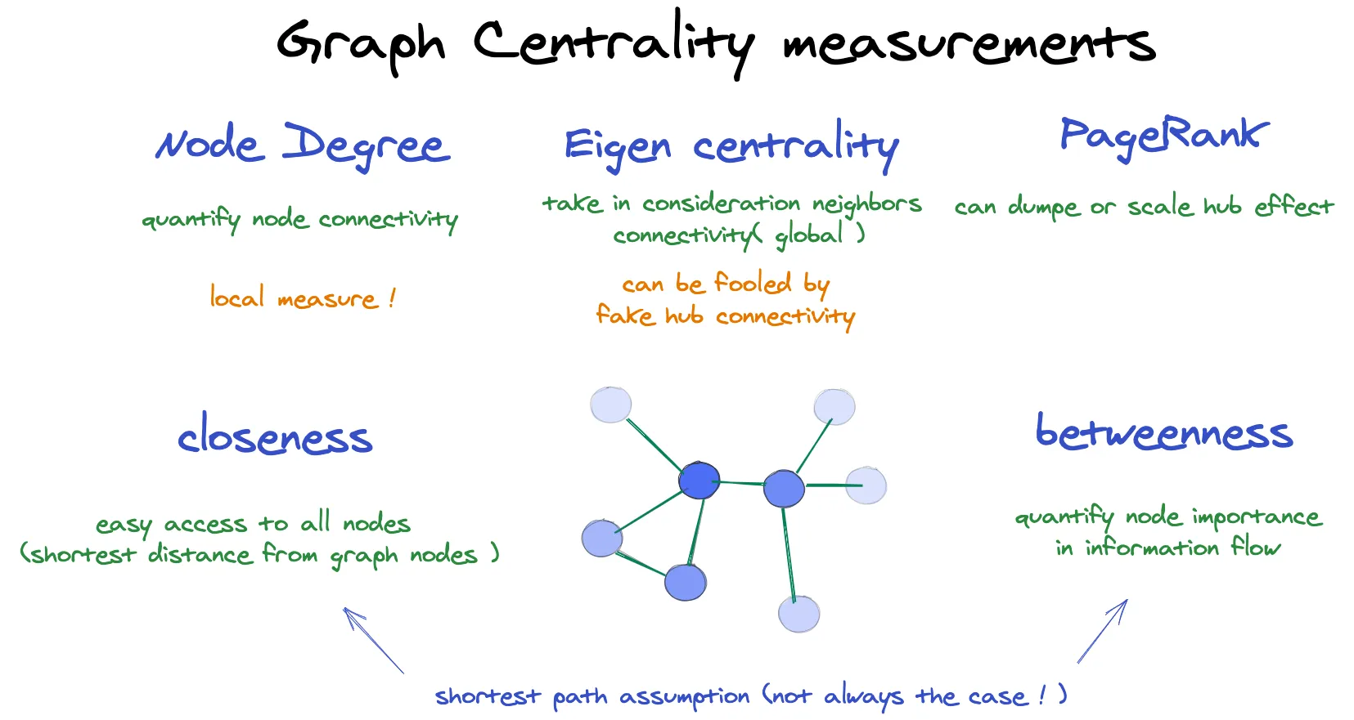
Eigenvector Centrality: the centrality of a node is determined by the principal eigenvector of the adjacency matrix of the network.
Closeness Centrality: it is calculated by taking the reciprocal of the sum of the shortest path distances from the node to all other nodes in the graph.
Betweenness Centrality: node with high betweenness centrality act as bridges or intermediaries between different parts of the network; find the proportion of shortest paths that pass through the node.

Slide 14
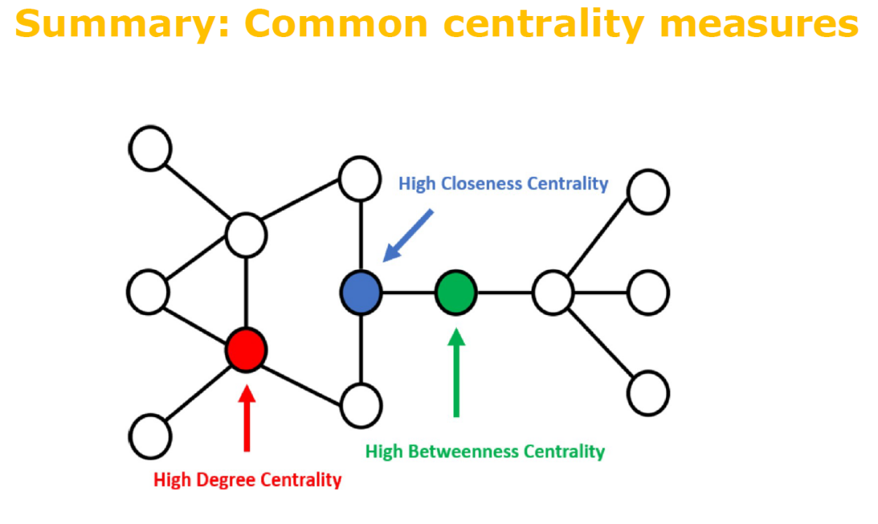

Slide 15
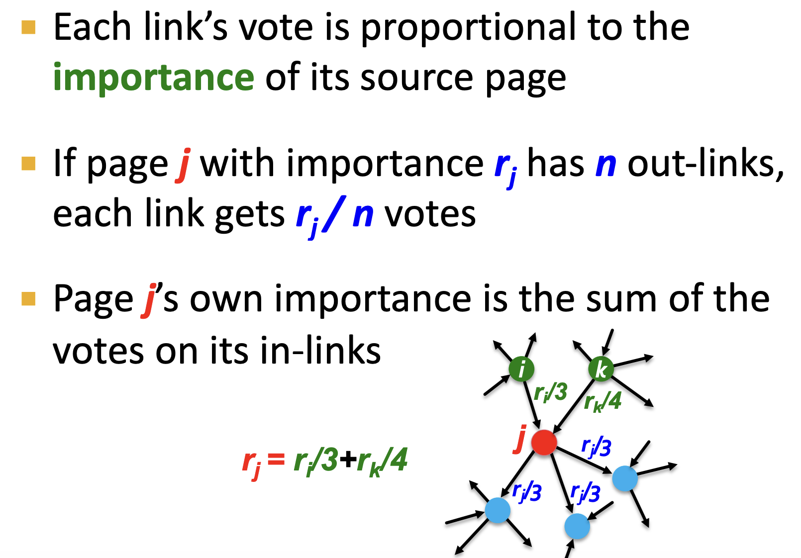
PageRank: Random Surfing

Slide 16
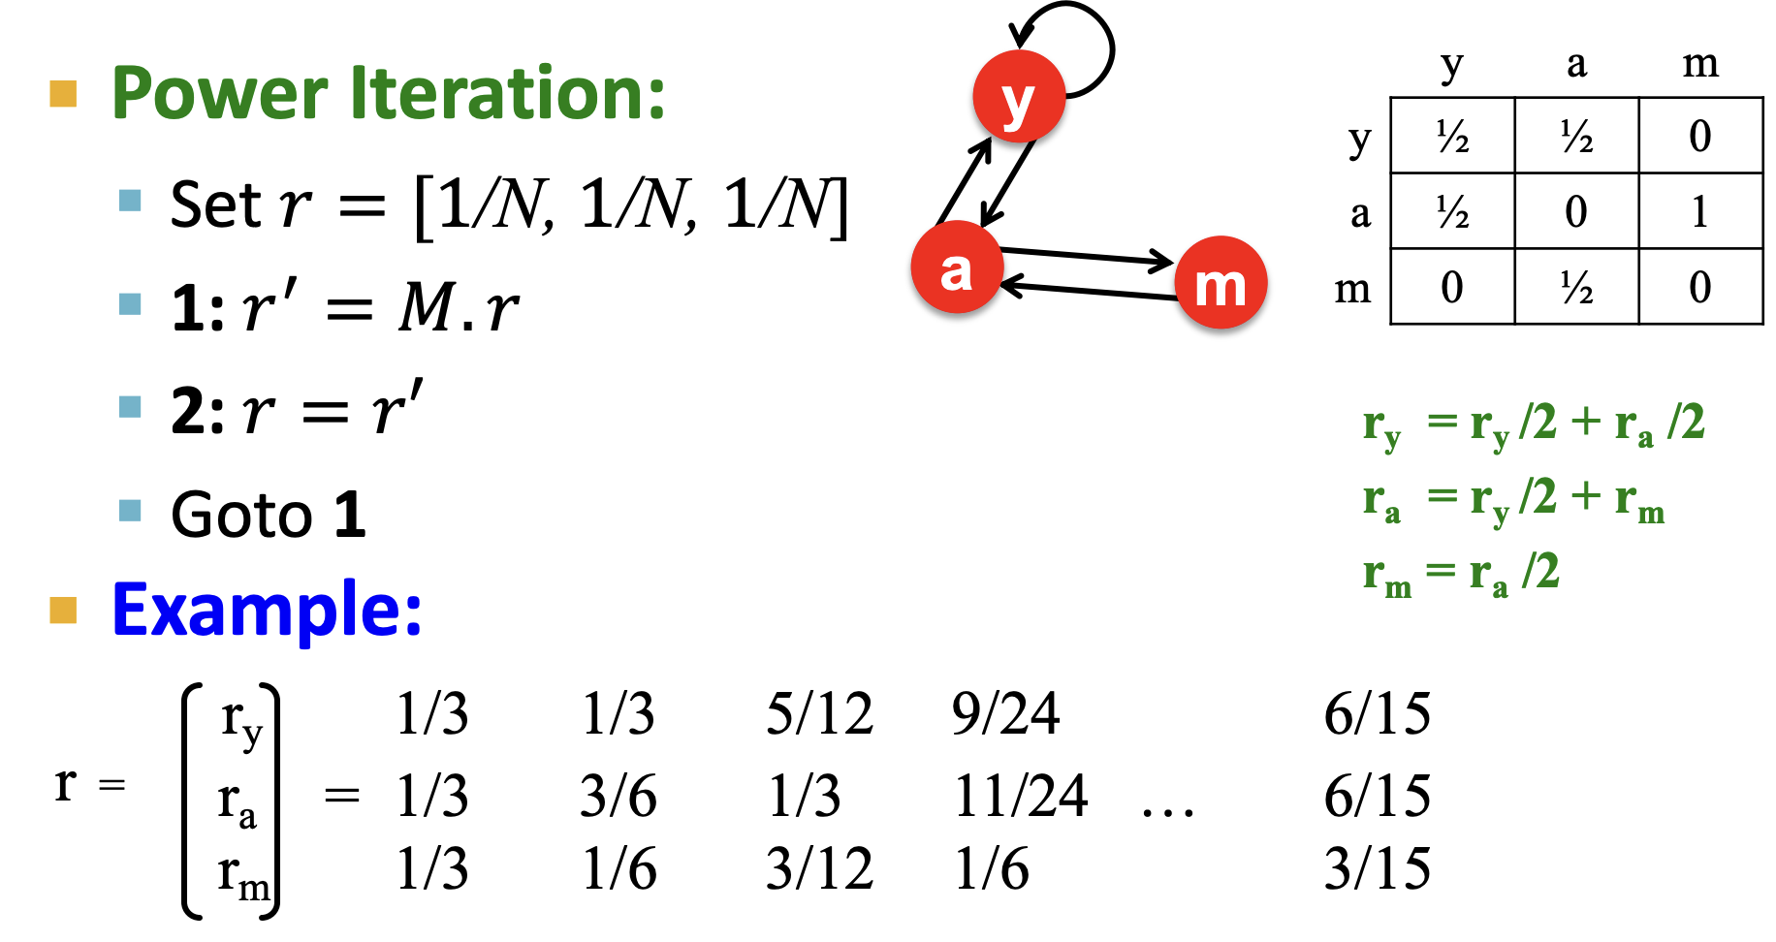
PageRank

Slide 17
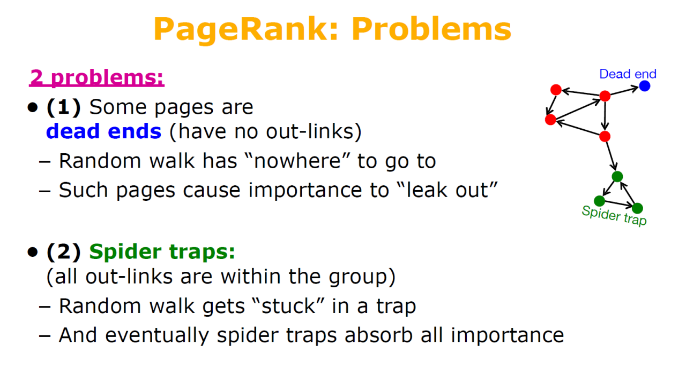

Slide 18
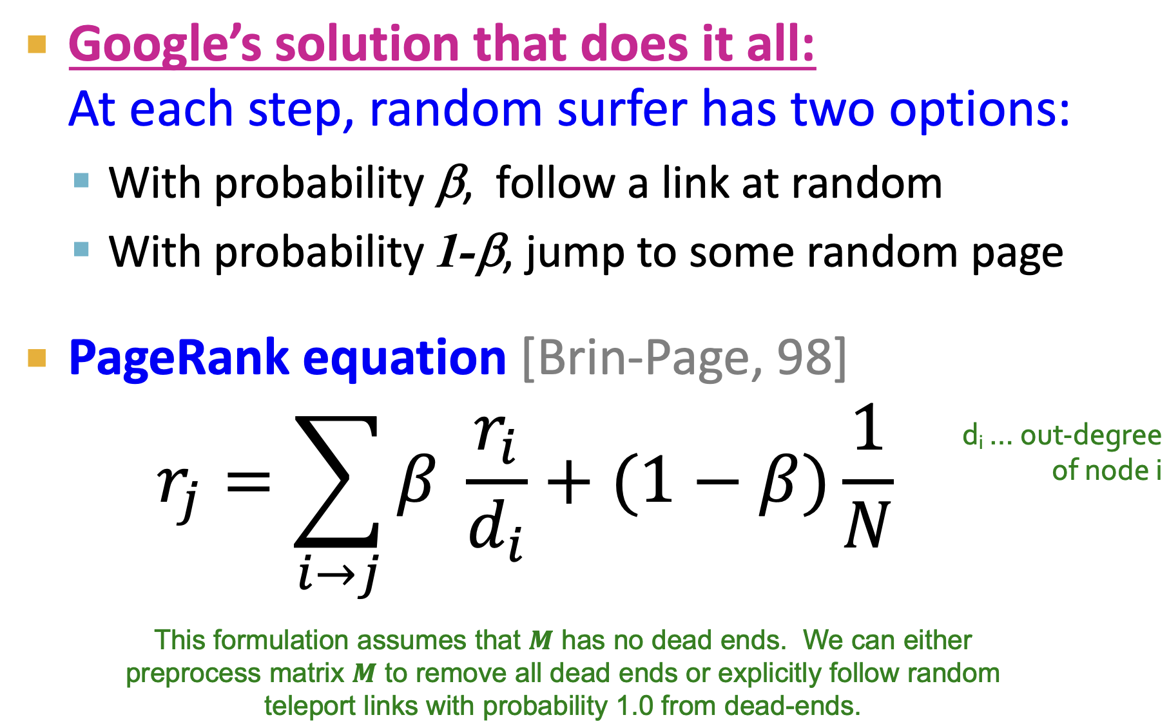
Notes:
Solution is to teleport; Pay attention to the dead ends

Slide 19
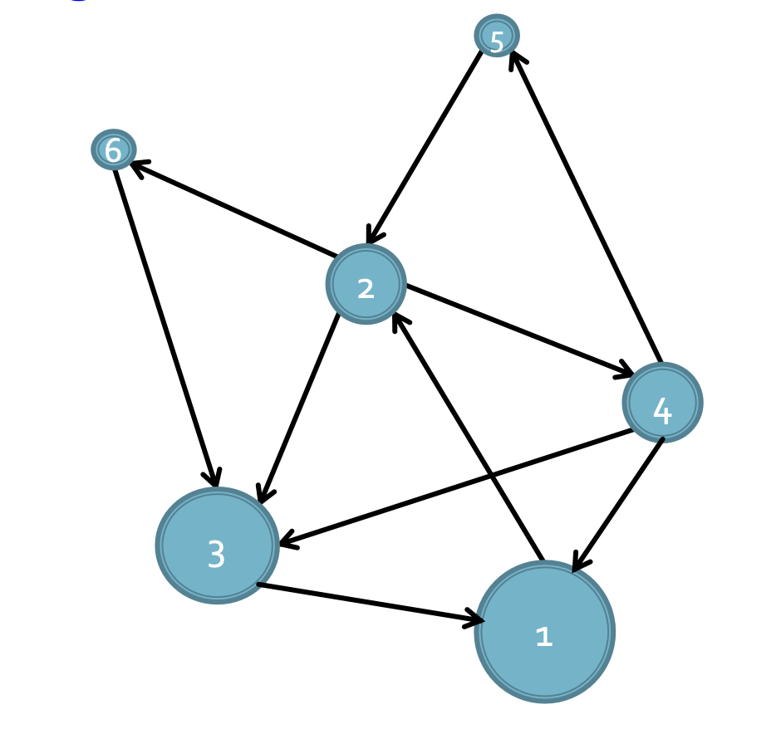
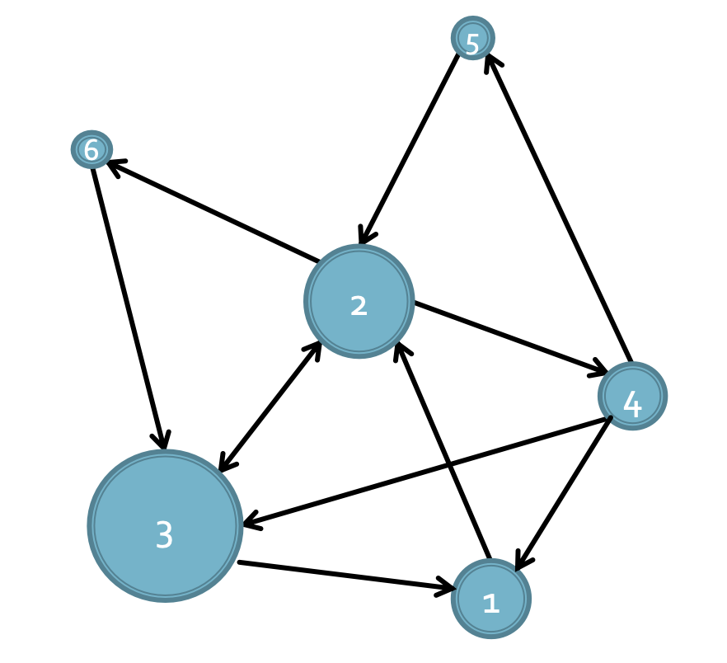
PageRank
Notes:
Node 1 has the highest PR, followed by Node 3, Degree ≠ PageRank
Add Edge 3 → 2. Node 3 has the highest PR, followed by 2. Small changes to graph can change PR!

Slide 20
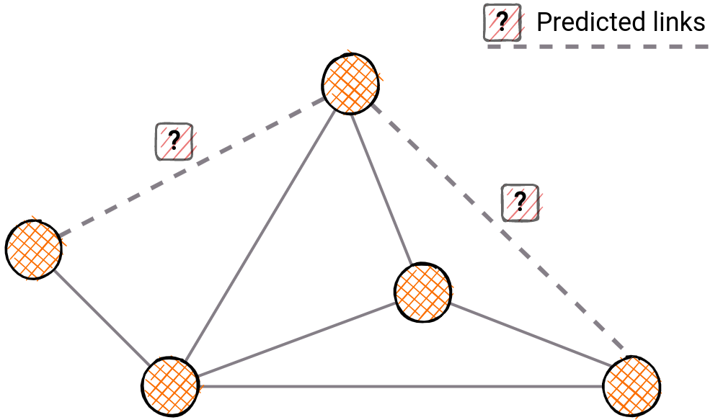
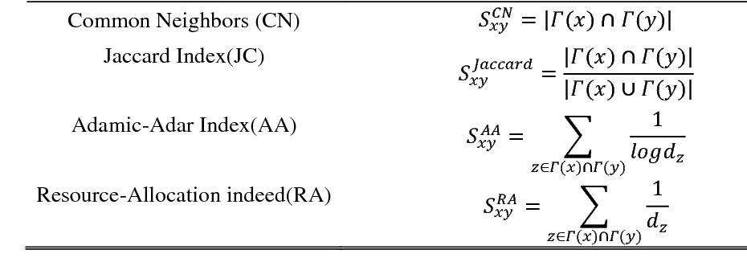
Link Prediction
Notes:
Adamic-Adar Index: The definition is based on the concept that common elements with very large neighbourhoods are less significant when predicting a connection between two nodes compared with elements shared between a small number of nodes.

